Slide 1

REINFORCEMENT EXCEL
Name : K. Tamilarasi
Domain / Batch:
DA/DS evening(online)

Slide 2
Project Overview & Objectives
Objective:
Analyze sales data from a retail business using Excel to identify key trends and insights.
Focus on sales performance across different categories and time periods.
Goals:
Analyze total sales, revenue trends, and the impact of discounts.
Identify the best-selling products and sales channels.
Generate actionable insights for business growth.

Slide 3
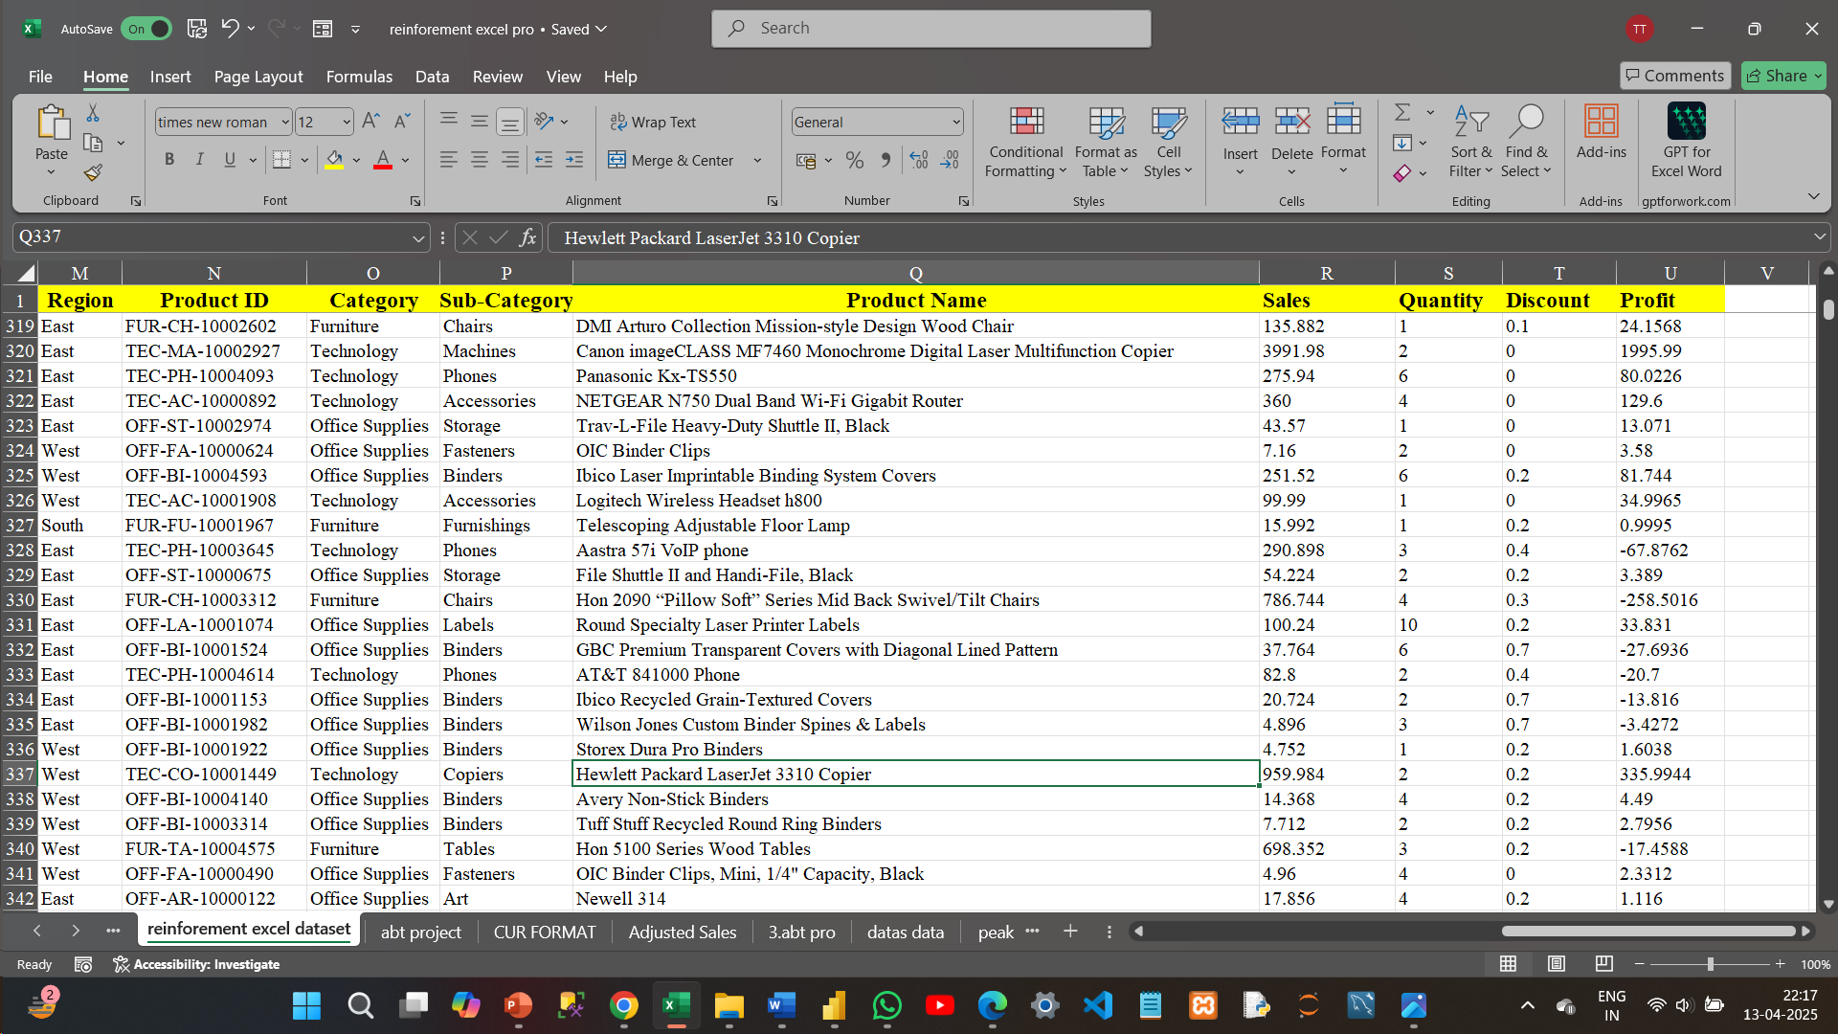
Project Overview & Objectives
Objective:
Analyze sales data from a retail business using Excel to identify key trends and insights.
Focus on sales performance across different categories and time periods.
Goals:
Analyze total sales, revenue trends, and the impact of discounts.
Identify the best-selling products and sales channels.
Generate actionable insights for business growth.

Slide 4
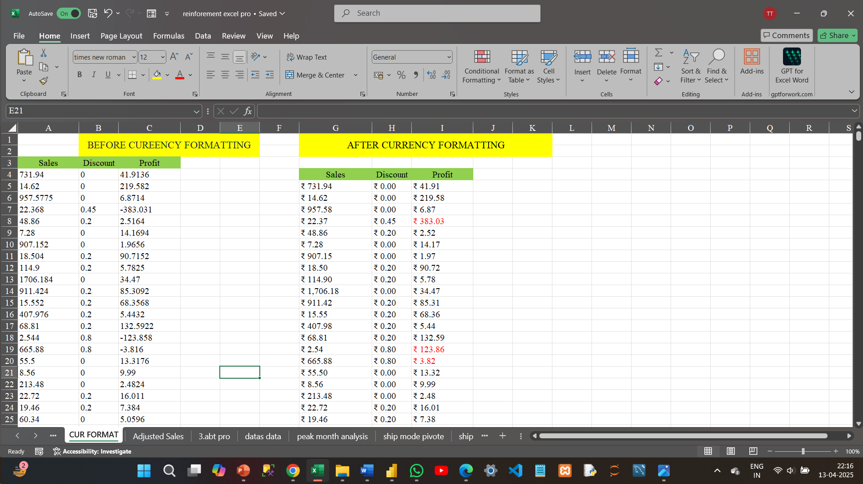
Dataset Overview & Preparation
Dataset Description:
The dataset consists of transaction-level details, including order IDs, product details, sales data, discounts, and customer information.
Data Cleaning and Preparation:
Removed duplicates and handled missing values.
Standardized data formats (e.g., date format, numerical fields).
Filtered and sorted the dataset for ease of analysis.

Slide 5
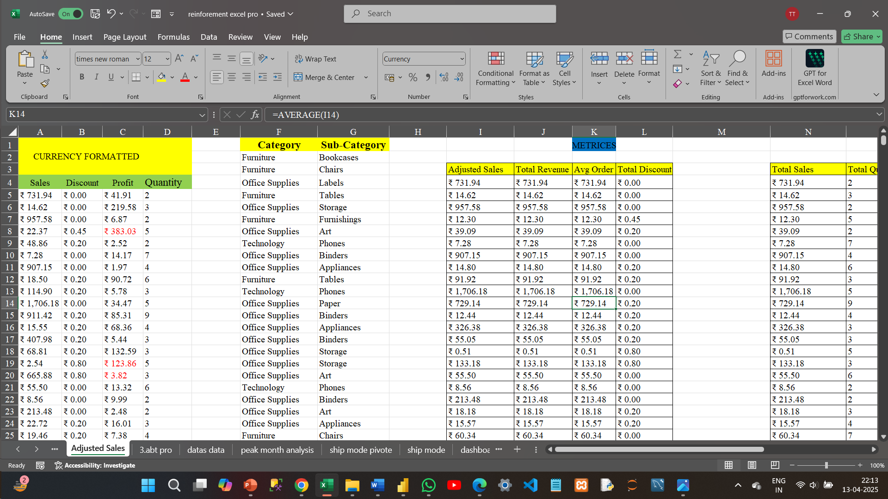
Key Metrics & Analysis in Excel
Key Metrics:
Total Sales: Summing up the sales amounts for all transactions.
Sales by Product Category: Analyzed sales across various product categories.
Discount Impact: Calculated the correlation between discounts and total sales.
Formulas Used:
SUM() for calculating total sales.
AVERAGE() for determining the average sales per transaction.

Slide 6
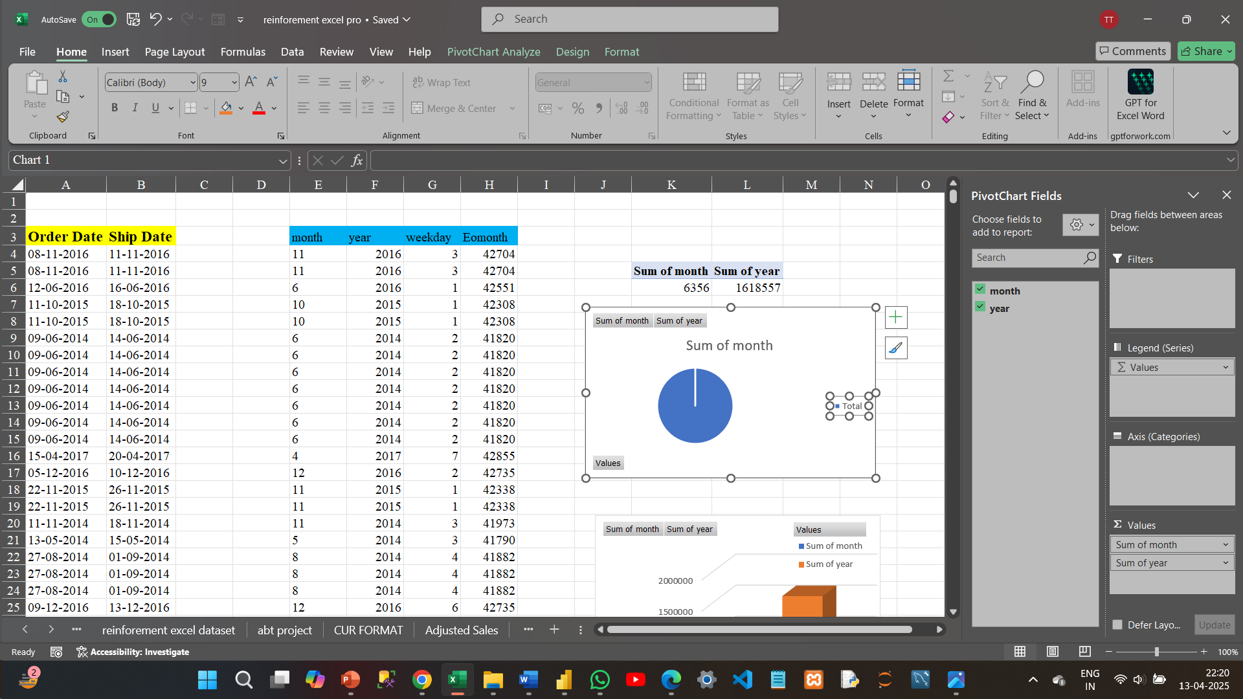
5: Sales Performance Analysis
Total Sales Analysis:
Calculated total revenue and compared it across different time periods (monthly/quarterly).
Identified top-performing months with the highest sales.
Excel pivot tables used to aggregate data by various dimensions like time, region, and product.

Slide 7
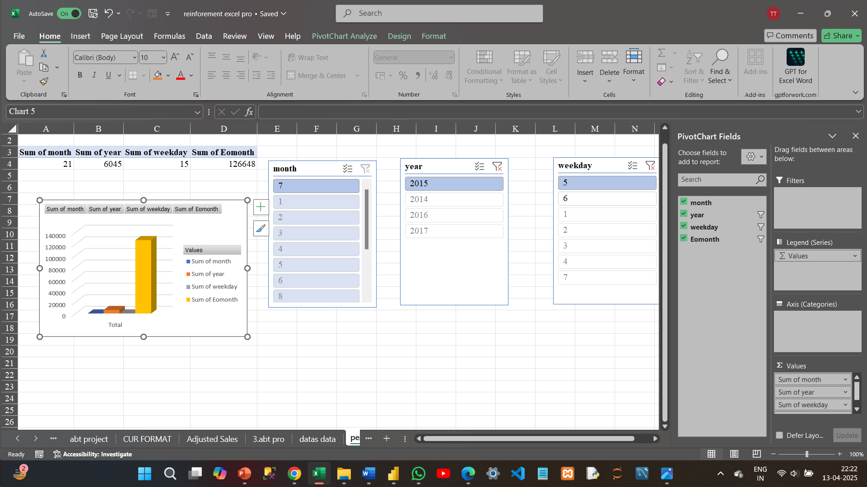
Discount & Sales Correlation
Discount Analysis:
Analyzed how discounts affected sales using Excel’s CORREL() function to measure the correlation.
Used scatter plots to visualize the relationship between discount rates and sales revenue.
Insights:
Found that higher discounts led to higher sales volume but decreased profit margins.
Excel formulas used to calculate the effectiveness of discounts on total revenue

Slide 8
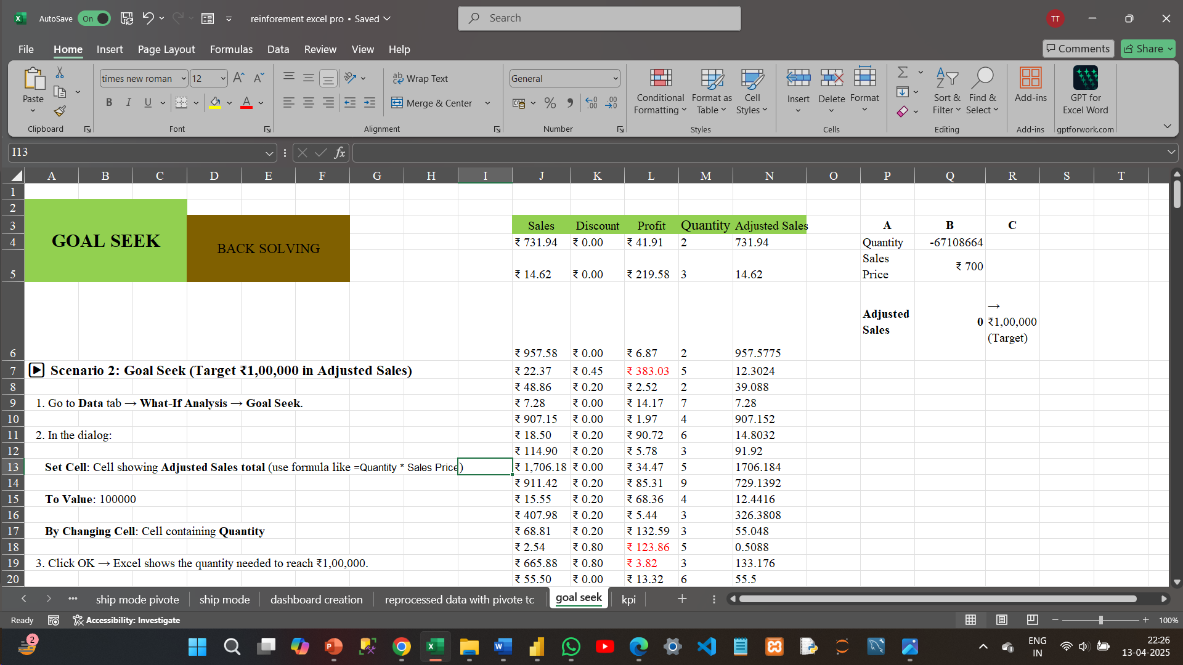
What-if-analysis
(Goal-seek)
Analyzed sales performance over goal seek to automate the functions to identify seasonal trends.
Used Excel what-if-analysis to illustrate the “goal seek” analysis.

Slide 9
THANK YOU

